Slide 1


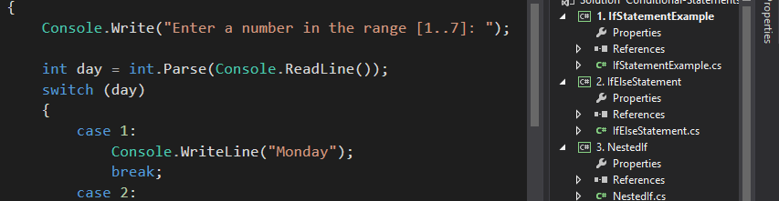

Programming for Beginners
Course Introduction
coding
SoftUni Team
Technical Trainers
Software University
http://softuni.bg

Slide 2


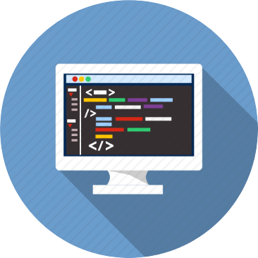
Table of Contents
Course Objectives
Course Program
Trainers Team
Examination
Learning Resources

Slide 3


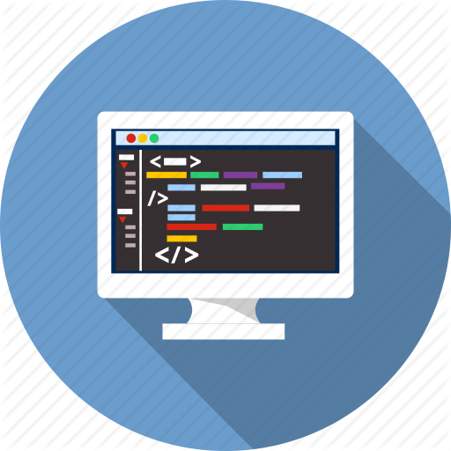
Programming for Beginners
Programming for Beginners
Course Objectives & Program

Slide 4
Course Objectives
The “Programming for Beginners" course:
Extends the coding skills gained from the "Coding 101" course
Add more typical programming skills needed by all developers
Enhances the algorithmic thinking and problems solving skills
Topics covered:
Data types and type conversion, methods, debugging
Collections of elements: arrays, lists, strings, dictionaries
Data processing with lambda functions and LINQ
Classes and objects (basics)

Slide 5
Course Topics
Course Intro. Data Types, Methods, Debugging
Arrays
Lists and Matrices
Strings, Dictionaries, Lambda and LINQ
Objects and Classes
Exam Simulation
Practical Exam

Slide 6
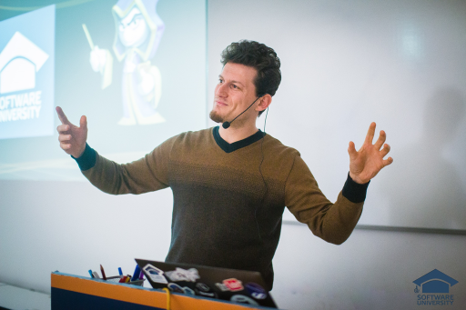
The Trainers Team

Slide 7
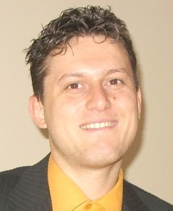
Trainers Team
Svetlin Nakov, PhD
Training & Inspiration Manager @ Software University
20+ years software development experience
10+ years experience as trainer
Author of 7 programming books
Winner in International programming contests and Olympiads
Speaker at hundreds of events
Web site & blog: www.nakov.com

Slide 8
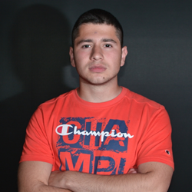

Trainers Team (2)
Преслав Михайлов
Software Engineer at Visteon
Top performing student from the Software University
Божидар Гевечанов
Software Engineer
Top performing student from the Software University

Slide 9

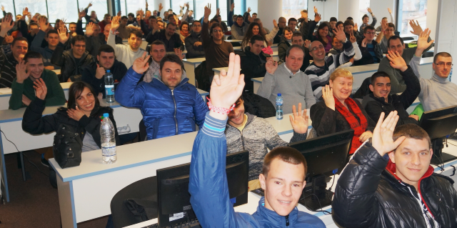

Mentors
10+ volunteer mentors
Top students from SoftUni
Top performers from previous programming courses

Slide 10
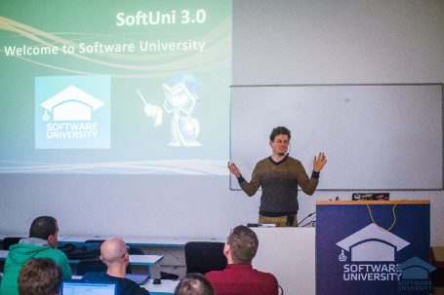


Programming for Beginners
Course Details and Schedule

Slide 11
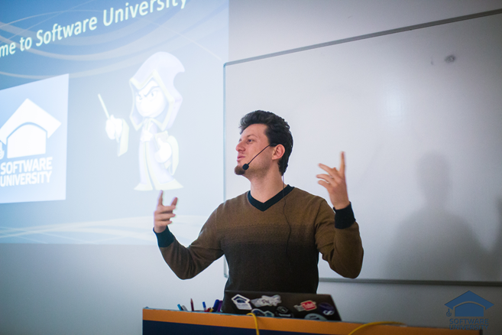
Training Duration
Lectures: ~ 10 hours (onsite + YouTube videos)
Practical exercises (in class): ~ 16 hours
Homework: ~ 10-20 hours
Exam: 6 hours
Allocation
Timeframe: March – April 2016
Exam: 24 April 2016

Slide 12


Why English?
Why the slides are in English?
English is the native language of the software engineers
Specific terminology should be in English
Translations are inaccurate and funny
Just learn English!
No excuses

Slide 13

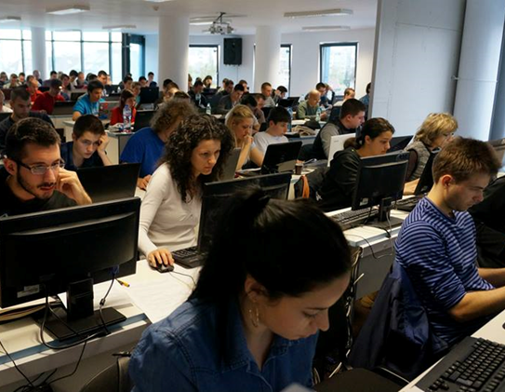
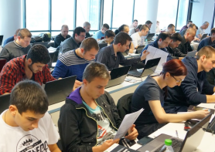
Programming for Beginners
Evaluation Criteria

Slide 14

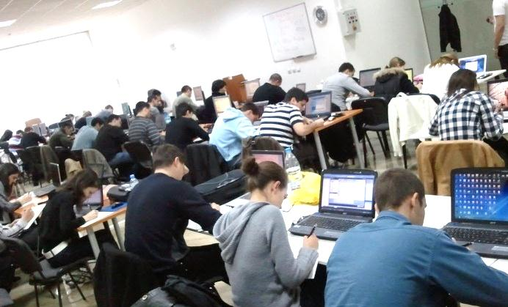
The Final Exam
Exams measure the individual performance
Do you have basic programming skills?
Course score formed by several components:
Exam results, homework, forums activity, etc.
The "Programming Basics" exam serves as admission criteria for the Software University
250 score required for admission (50%)
Lower score → repeat / basic courses

Slide 15
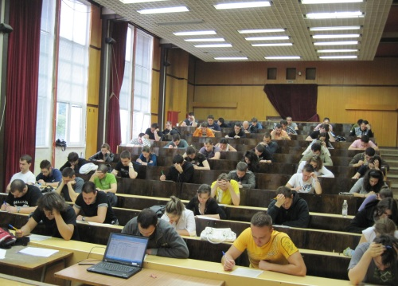

Programming for Beginners Exam
The practical programming exam explained
5 practical problems for 6 hours
Simple calculations + simple logic
Loops + simple logic
Drawing figures at the console (loops)
Arrays – processing sequential data
Matrices – processing table data
Automated judge system & real-time feedback

Slide 16

Programming Exam – Sample Problem
Draw at the console a diamond of size n (1 ≤ n ≤ 100) :
n = 2
n = 3
n = 4
n = 5
*
*-*
*
*
*-*
*-*-*
*-*
*
*
*-*
*-*-*
*-*-*-*
*-*-*
*-*
*
*
*-*
*-*-*
*-*-*-*
*-*-*-*-*
*-*-*-*
*-*-*
*-*
*
Test your solution: https://judge.softuni.bg/Contests/Practice/Index/157#8

Slide 17
Programming Exam – Sample Solution
var n = int.Parse(Console.ReadLine());
for (int row = 1; row <= n; row++)
{
Console.Write("{0}*", new string(' ', n - row));
for (int i = 0; i < row-1; i++)
Console.Write("-*");
Console.WriteLine();
}
for (int row = n-1; row > 0; row--)
{
Console.Write("{0}*", new string(' ', n - row));
for (int i = 0; i < row - 1; i++)
Console.Write("-*");
Console.WriteLine();
}

Slide 18

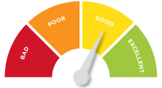

Scoring System for the Course
Onsite students
Final exam – 75%
Intermediate exam – 15%
Working with mentor – 5%
Homework – 5%
Online students
Final exam – 100%
Forum activity – bonus up to 10%

Slide 19


Final Exam – What Comes Next?
exam score
0
250
350
400
500
Bank loan?
485
Fail
Pass
Good
Champion
?
Try again / join basic courses
Join the "Software Technologies" module
Apply for scholarship

Slide 20
SoftUni: Curriculum, Modules, Timeline
Free Entry
Module
9
Programming Basics
4 months
Coding for beginners
Programming Basics
> 50% exam → Enter SoftUni
> 97% exam → Scholarship
Admission Exam
Software Technologies
Orientation
Module
12
4 months
HTML + JavaScript
PHP + MySQL
C# Web
Java Web
Select desired profession
Professional
Modules
8-24 months
Professional Qualification

Slide 21
JavaScript / PHP Developer Profession
JS Core
PHP Fundamentals
2 x 4 months
mandatory
27
24
> 70 credits
Start a job
MEAN Stack
PHP Web
27
27
9
9
Web Basics
Web Basics
2 x 4 months
essential
courses
Data Structures & Algo
JS Core
24
27
IT Basics
9
IT Basics
9
> 130 credits
Diploma
Embedded & Mobile
Embedded & Mobile
9
9

Slide 22
C# / Java Web Developer Profession
C# Fundamentals
Java Fundamentals
3 x 4 months
mandatory
courses
27
27
DB Fundamentals
DB Fundamentals
27
27
> 100 credits
start a job
C# Web
Java Web
27
27
JS Core
JS Core
2 x 4 months
essential
courses
27
27
Data Structures & Algo
Data Structures & Algo
24
24
Web Basics
Web Basics
9
9
> 170 credits
Diploma
Embedded & Mobile
Embedded & Mobile
9
9

Slide 23

Homework Assignments
Doing your homework is very important!
Programming can only be learned through a lot of practice!
You should write code every day!
Each topic is followed by a few exercises
Try to solve them in class
The rest are your homework
Homework assignments are due in 1 week after each lecture
Submission are accepted in the judge system: judge.softuni.bg

Slide 24









Resources
What We Need Additionally?

Slide 25

Course Web Site & Forums
The Programming Basics official web site:
Register for the "Software University Forum":
Discuss the course exercises with your colleagues
Find solutions for all course exercises
Share source code / discuss ideas / help each other
https://softuni.bg/courses/programming-basics/
http://softuni.bg/forum

Slide 26



The Programming Basics Slides and Videos
All lecture slides, videos, homework assignments, projects and other resources are open content, available for free
Visit the course web site to access the course resources

Slide 27

The Free C# Fundamentals Textbook
The official textbook for the course
"Fundamentals of Computer Programming with C#", by Svetlin Nakov & Co., 2013, ISBN 9789544007737
English and Bulgarian versions (as PDF, ePub, …)
Freely downloadable from: www.introprogramming.info
The C# Programming courses @ SoftUni.bg partially follows the book
Programming Basics → chapters 2, 3, 7, 9, 11, 13, 14, 16, 18

Slide 28


Required Software
Software needed for this course:
Microsoft Windows (Win 10 / 8.1 / Win8 / Win7)
Visual Studio Community 2015 (a free version of VS 2015)
Visual Studio 2013, 2012, 2010 acceptable, but not recommended
.NET Framework 4.6 (included in Visual Studio)

Slide 29

Summary
The “Programming for Beginners" course
Basic programming skills after "Coding 101"
Training program
Data types, methods, debugging, arrays, lists, strings, dictionaries, lambda, classes, objects
Practical exams
Automated judge system + score system
Learning resources
Lectures, videos, software, books, forum
Programming for Beginners

Slide 30








Programming for Beginners – Course Intro
https://softuni.bg/courses/programming-basics/

Slide 31
License
This course (slides, examples, demos, videos, homework, etc.) is licensed under the "Creative Commons Attribution-NonCommercial-ShareAlike 4.0 International" license
Attribution: this work may contain portions from
"Fundamentals of Computer Programming with C#" book by Svetlin Nakov & Co. under CC-BY-SA license

Slide 32






Free Trainings @ Software University
Software University Foundation – softuni.org
Software University – High-Quality Education, Profession and Job for Software Developers
softuni.bg
Software University @ Facebook
facebook.com/SoftwareUniversity
Software University @ YouTube
youtube.com/SoftwareUniversity
Software University Forums – forum.softuni.bg

